Slide 1
Machine Learning Internship
Katihar Engineering College
Submitted by:- Vishal kumar Singh Submitted to:- Dharmveer Sir

Slide 2
Contents
Introduction to Machine Learning
Data
Python
Data Exploration
Linear Regression
Logistic Regression
Decision Tree
Ensemble Model
Clustering
Project

Slide 3
Introduction to Machine Learning
Machine Learning is a field of study that gives computers the capability to learn without being explicitly programmed.
Machine Learning is one of the most exciting technology that one would have ever come across

Slide 4
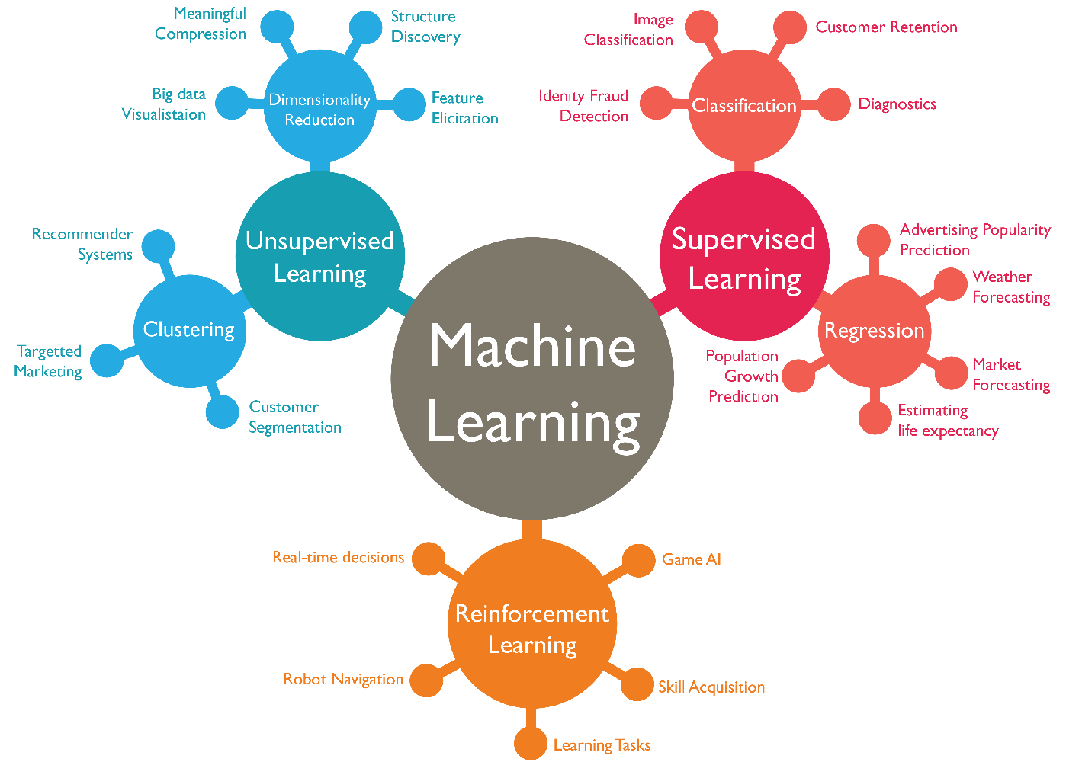

Slide 5
Introduction to Machine Learning
There are two types of Machine Learning:- Supervised Learning and Unsupervised Learning.
In Supervised Learning the machine is trained on input data that has been labelled for a particular output.
In Unsupervised Learning the machine is trained on input data that has not been labelled.

Slide 6
Data
Data is an unprocessed fact , value , text , sound, or picture that is not being interpreted and analysed.
It is the most important of all Data analytics , Machine Learning , Artificial Intelligence.
The Machine learning model is trained from data or some specifications and allowed to predict the outcome from the trained data.
The Data can be organized , unorganized , cat.egorical or ordinal

Slide 7

Python
Python is a programming as well as scripting language which is mostly used in Machine Learning and Artificial Intelligence.
It is an interpreted language and the code is easy to understand and easy to debug
To perform any operation in python it requires significantly lesser number of lines of code.
This makes the Python language to be best option for machine learning and Data Science

Slide 8
Data Exploration
Data Exploration is first step in data analysis involves visualization tools and statistical techniques
This is done to uncover data set characteristics and initial patterns.
Exploration enables us to identify how the data is spread by examining the mean median mode
In Python to explore any set of data we have a simple method over the DataFrame and Series Object which is describe()
result = df.describe()

Slide 9
Data Exploration
Another aspects of Data Exploration is data Visualization.
Data can be visualized using multiple techniques or chart or graphs
Bar Chart , Scatter Plot , WhiskerPlot , Box Plot are the majorly used examples of visualization of data.

Slide 10
Linear Regression
Linear Regression is a machine learning algorithm based on supervised learning.
It performs regression task.
It predicts the target dependent values from provided independent values by examining the previous data set.
It finds the best fit line that can give as accurate predicted value as possible

Slide 11
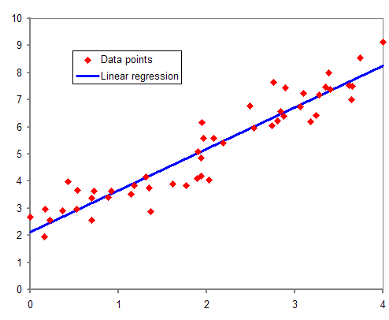

Slide 12
Logistics Regression
Logistics Regression also works on Supervised Machine learning model.
This model is used to predict the categorical dependent variable using a given set of independent variables.
It gives discrete value as result.
It uses the predictive modeling as regression therefore it is called logistic regression

Slide 13
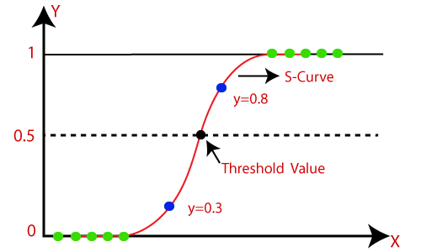

Slide 14
Decision Tree
Decision tree is the most powerful and popular tool for classification and prediction.
A Decision tree is a flow chart like tree structure where each internal node denotes a test on an attribute

Slide 15
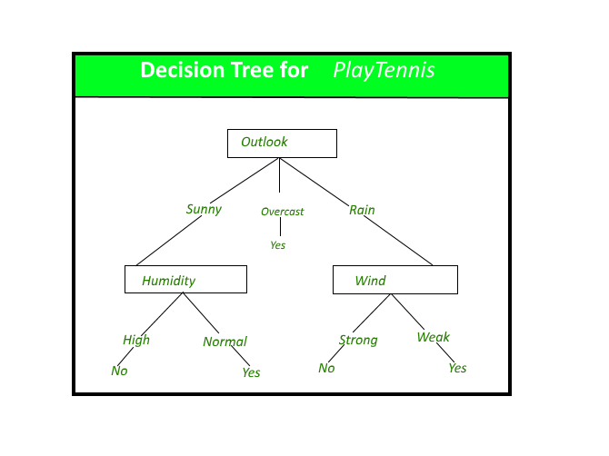

Slide 16
Ensemble Model
Ensemble modeling is a process where multiple diverse models are created to predict an outcome.
Either it uses multiple different modelling algorithms or using different training data sets.
After that the result is aggregated and final predictions or done for the unseen data.

Slide 17
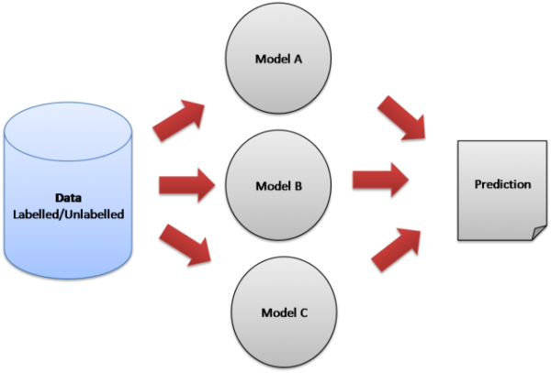

Slide 18
Clustering
Clustering is a type of unsupervised machine learning method.
An Unsupervised learning method is a method in which we references from datasets consisting input data without labeled responses

Slide 19
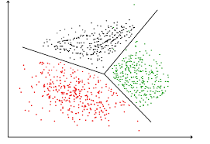

Slide 20
Project
The project name is OMR Evaluator.
It is designed to reduce the workload while checking OMR manually. This project helps OMR evaluator to evaluate OMRs automatically with the help of Machine Learning.
The project is helpful for all those teachers and exam organisers who evaluates the OMR manually.

Slide 21
OMR Evaluator : Working
The user needs to upload the picture of OMR clicked neatly and leave the rest on us.
The software is designed to evaluate the OMR by using Computer Vision which is a subset of Machine Learning.
The user friendly dashboard is designed to give awesome user experiences while navigating to different services.
OMR Evaluator is capable of monitoring student records in their OMR based examinations also provides an easy to use by teacher and to prepare the results

Slide 22
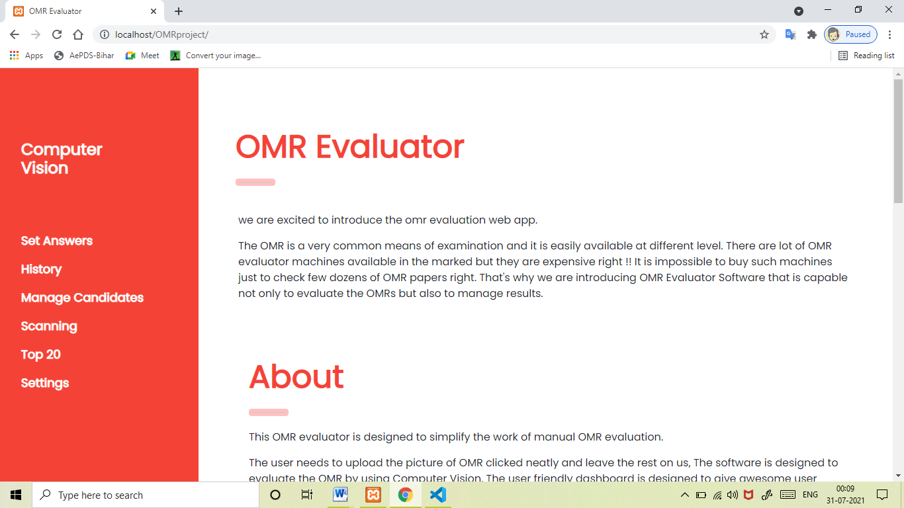
OMR Evaluator : UI

Slide 23
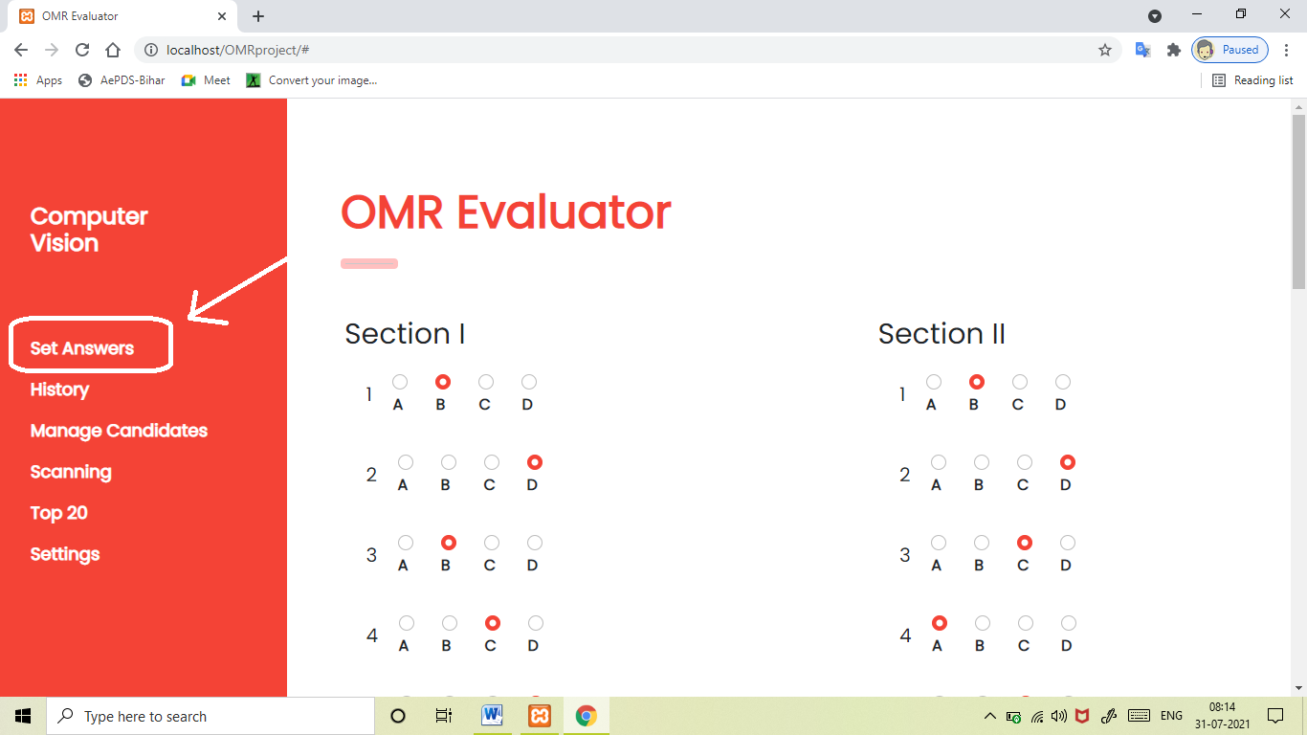
Once the scanning is done the user need to set the answers from the “Set Answers” section.

Slide 24
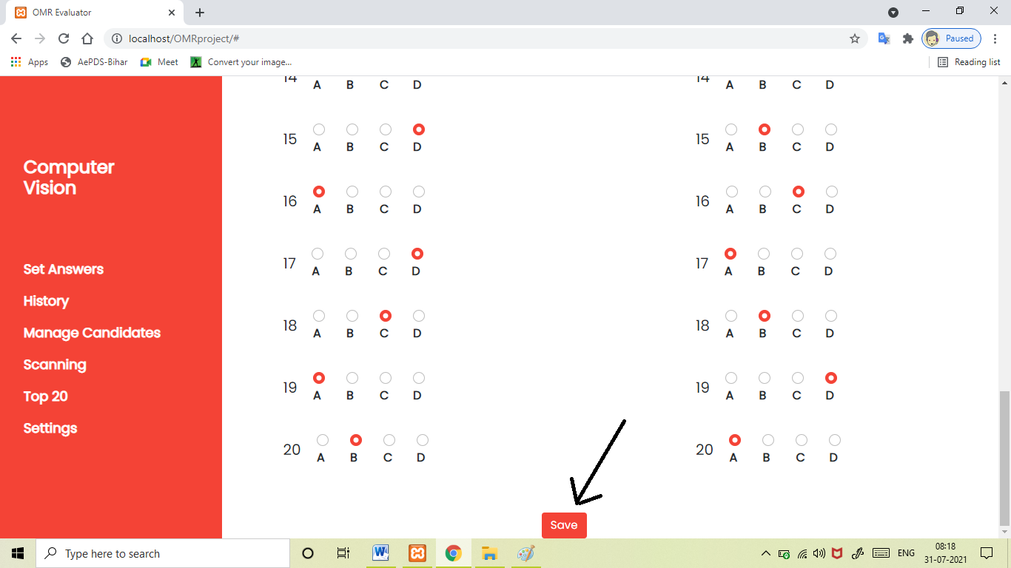
After setting all the answers the user need to save there credentials by clicking on Save button

Slide 25
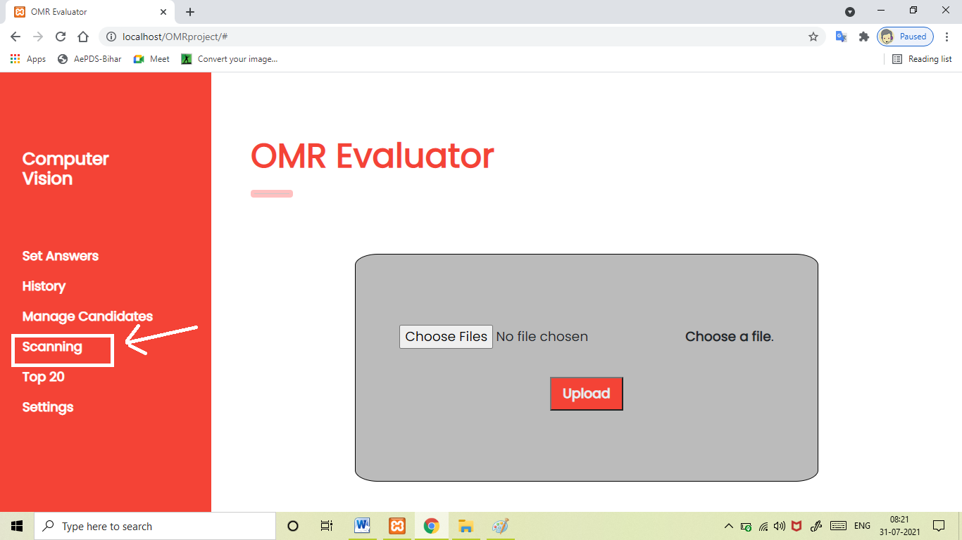
After answer is set we need to upload the OMR one by one. This can be done in Scanning” section

Slide 26
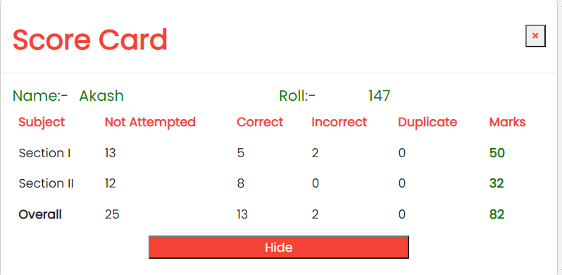
After choosing the OMR picture files the user need to click on the upload to upload picture to server. The server will automatically fetch the result and show as a popup box containing OMR details in front of you

